Slide 1
Mobile Apps Research Lab, Software Development Core
Android Programming
Meeting #2

Slide 2
Android as a Language
For past 20+ years, web programming has involved multiple high-level languages, requiring server-side processing for low-level languages & data management:
HTML (basic content & positioning)
XML, CSS
Server-side scripting
Javascript
Significant cross-browser compatibility issues
Low-level: perl/php/python/java coupled with database languages
Android uses java and XML to combine all of these core capabilities in one platform
Faster than server-based communication and processing, but with strict limitations
Capacity to communicate directly and securely with web servers

Slide 3
Benefits
Java is a powerful tool for:
For animation & gameplay
For secure transmission of data
For maintaining state and tailoring to the user
Challenge
Learning to use these complex tools to make an engaging app

Slide 4
Practice Exercise 1.
Create a basic android app with layout for question and two response buttons.
☐ Download & install Android Developer Tools
☐ Launch a new android application project
☐ Layout the user interface

Slide 5
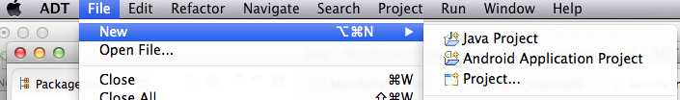
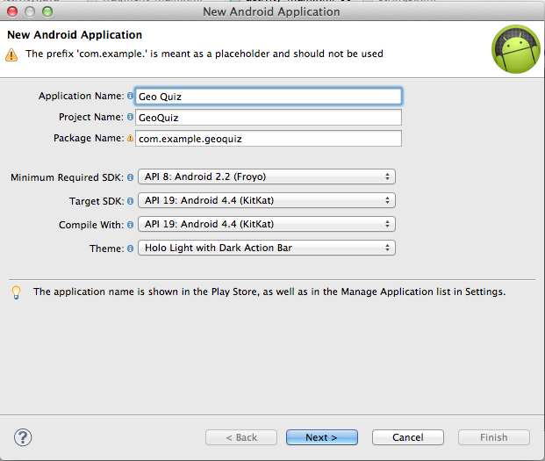
Create a basic android app with layout for question and two response buttons.

Slide 6
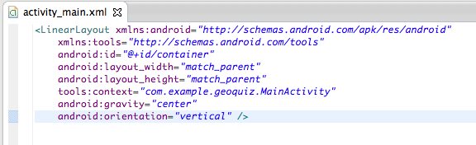
Modify “activity_main.xml”
Can copy & paste from AndroidSolutions on github
But BETTER for learning if you force yourself to bang out the code
Leave line IN with android:id=“@+id/container”

Slide 7

For example…
XML tags can be closed in one of two ways:
1. by having a distinct closing tag, e.g., </Button>, displayed after any containing xml
2. by closing the tag

Slide 8
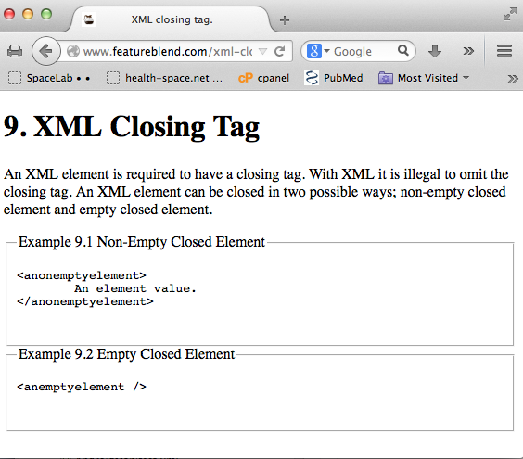
Create a basic android app with layout for question and two response buttons.
Modify “activity_main.xml”

Slide 9
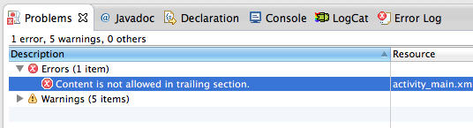
Create a basic android app with layout for question and two response buttons.
Error checking: look at Problems, Console, and Error Log first
Identify specific files and line numbers, where possible
Google the problem e.g.,“content is not allowed in trailing section” & learn about the error
Frequently clear error logs (& give time for saving & rebuilding the app)

Slide 10
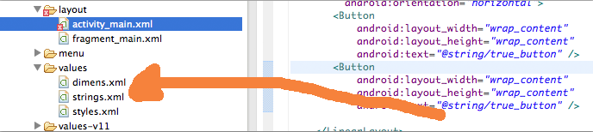
Unlike HTML, layout is ONLY for layout.
All text content, including text descriptions, colors, sizes, etc. are contained in .XML files in the values folder

Slide 11
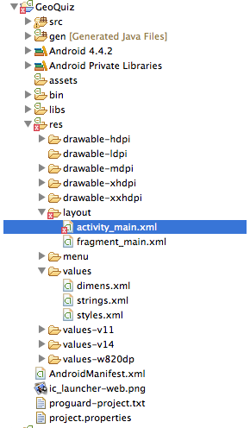
All graphics are stored in the resources folder.
Images must be customized for a variety of screen sizes & resolutions.

Slide 12
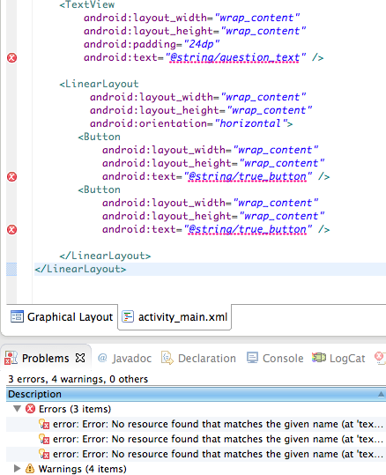

Slide 13
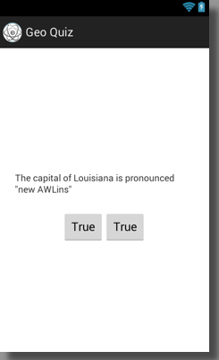
Change text size:
Change button background colors:

Slide 14
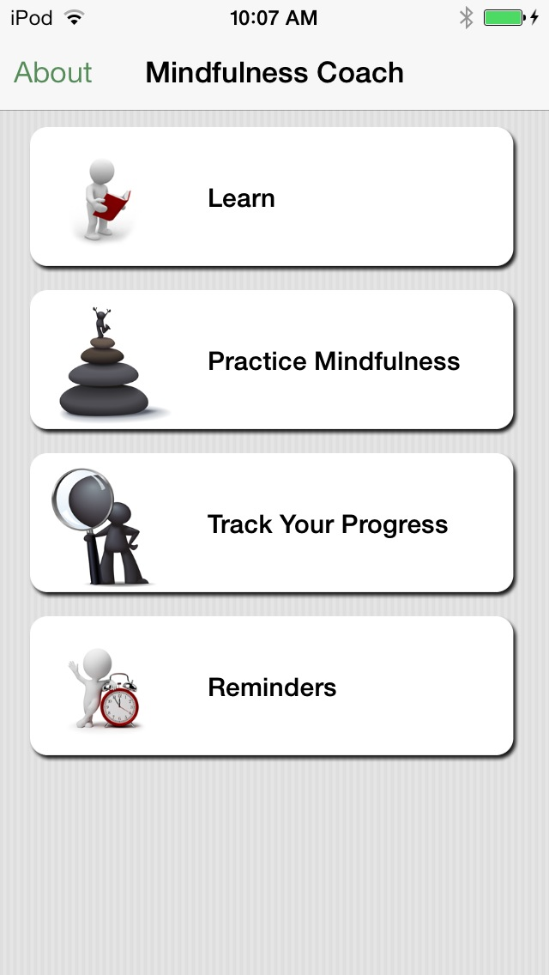
Mindfulness Coach
Relatively simple app
Only available on iOS
No plans to add Android
Low priority for instrumentation

Slide 15
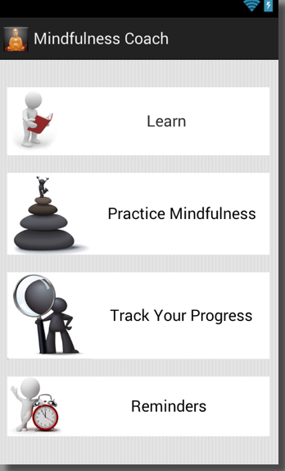
Current iOS home page
Android port of iOS layout.

Slide 16
Potential Add-Ons
Switch easily from portrait to landscape orientation
Fluid button layout, home screen includes swipe navigation
Submits usage data to research server
First-use log-in for research participants
______________________

Slide 17
Tasks for Meeting 3
Log the activity life cycle of GeoQuiz
Wire Mindfulness Coach “Learn” button to display another menu of learning options (see iOS app)
Allow rotation from portrait to landscape in GeoQuiz and/or Mindfulness Coach
________________
________________

